Slide 1
The world happiness Analysis
The Merry Team…..
Proudly present
By Rye Capati, Cicily George, Bimal Prabha and Sandra Teh

Slide 2
Jupyter notebook
Data Sources
Kaggle: https://www.kaggle.com/mathurinache/world-happiness-report?select=2020.csv
Google Map: https://cloud.google.com/maps-platform/
Institute of Health Metrics and Evaluation (IHME), Global Burden of Disease (GBD): http://ghdx.healthdata.org/gbd-results-tool
Rest Countries API: https://restcountries.eu/rest/v2/

Slide 3
The world happiness Analysis

Slide 4

How happy we are compared to the world??
Notes:
Starting by asking everyone question..

Slide 5

Australia Ranking 2015 to 2019
Year | Happiness Rank
2015 | 10
2016 | 9
2017 | 10
2018 | 10
2019 | 11

Slide 6
7 factors that determine the happiness score
Economy (GDP per capita)
Family(Social Support)
Health and Life Expectancy
Freedom to make life choices
Trust (Perception of Government Corruption)
Generosity
Dystopia Residual

Slide 7
the top 10 countries? The Bottom 10 countries?

Slide 8
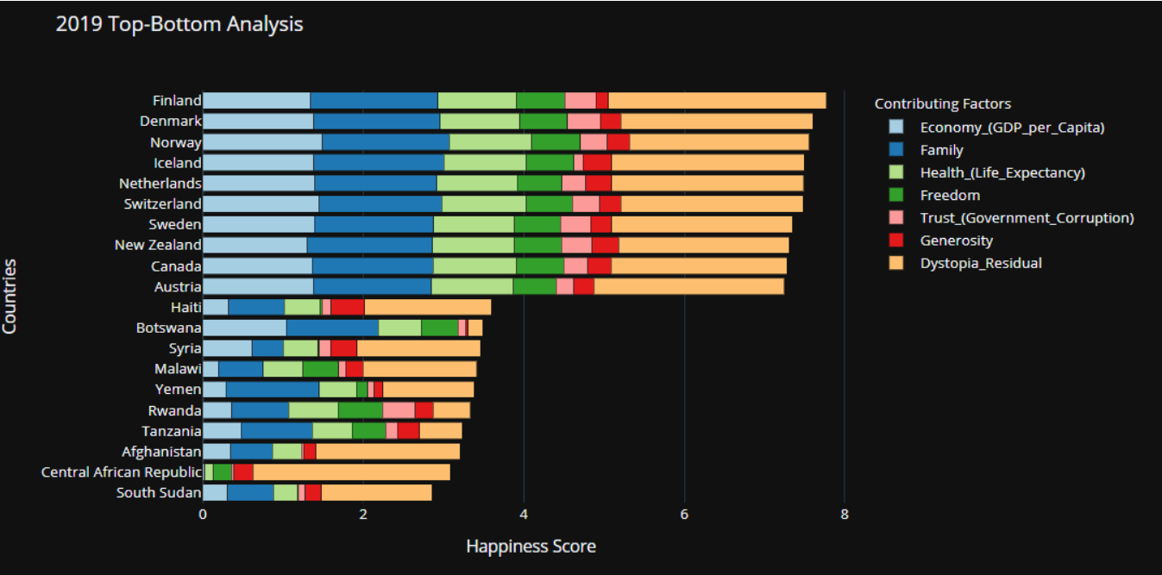
the top 10 countries The Bottom 10 countries

Slide 9
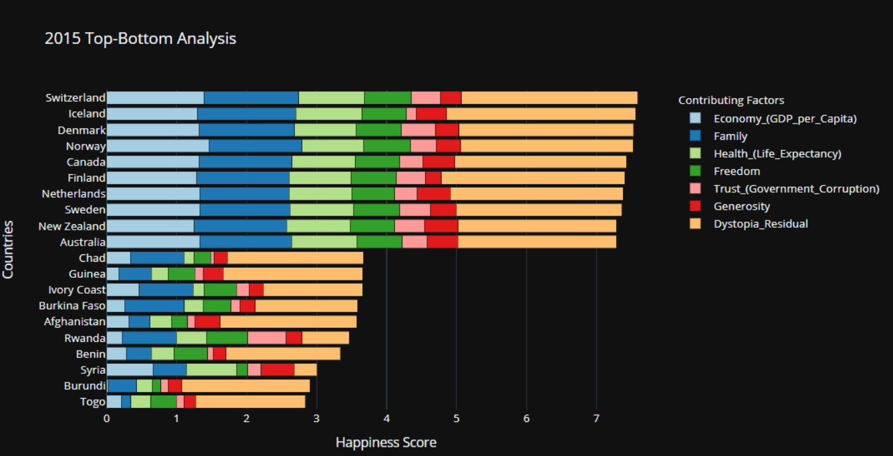
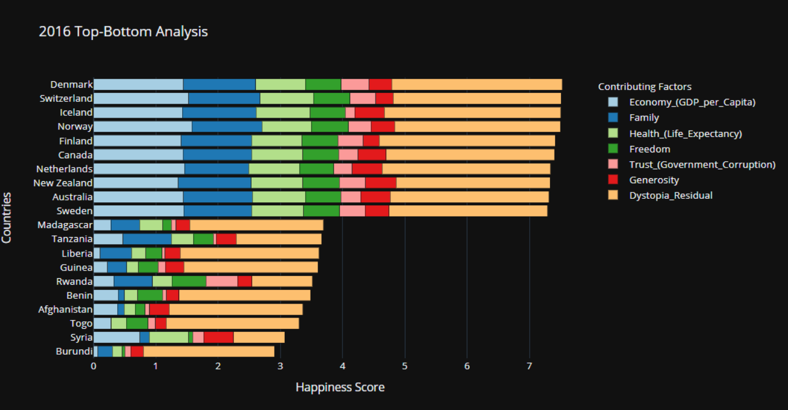
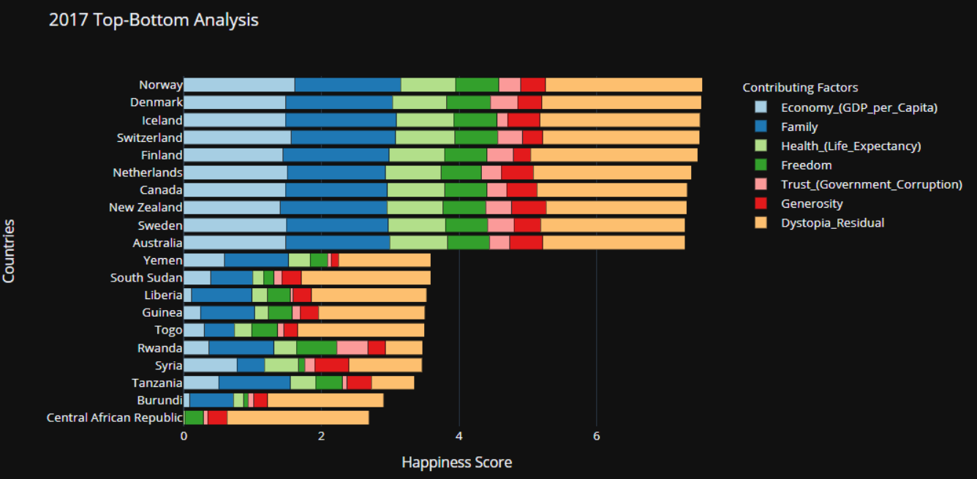
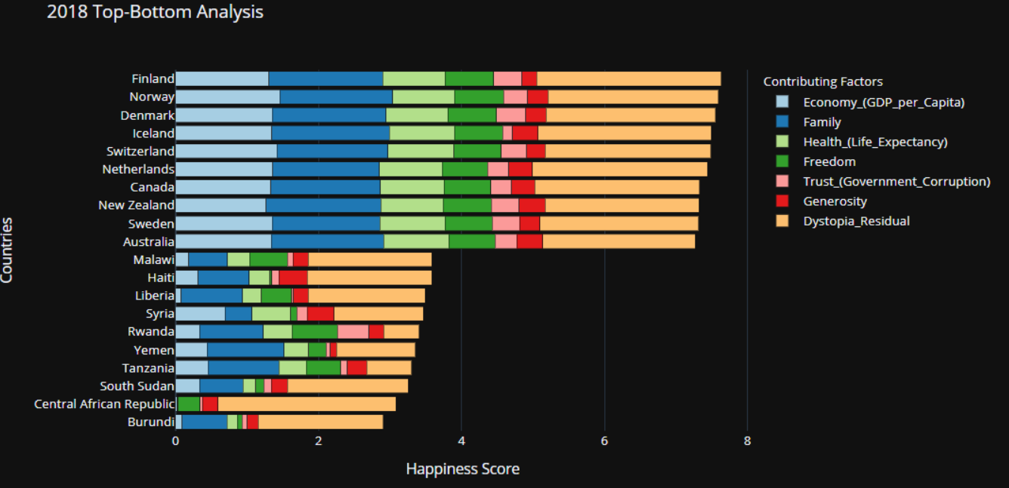

Slide 10
Are those factors correlated?

Slide 11
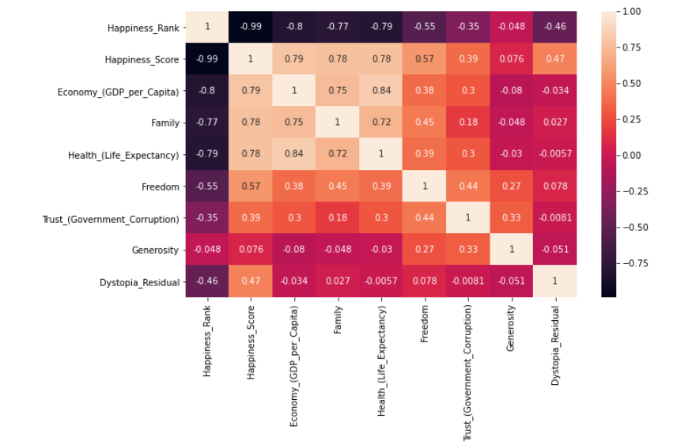
Are those factors correlated?
Year 2019

Slide 12
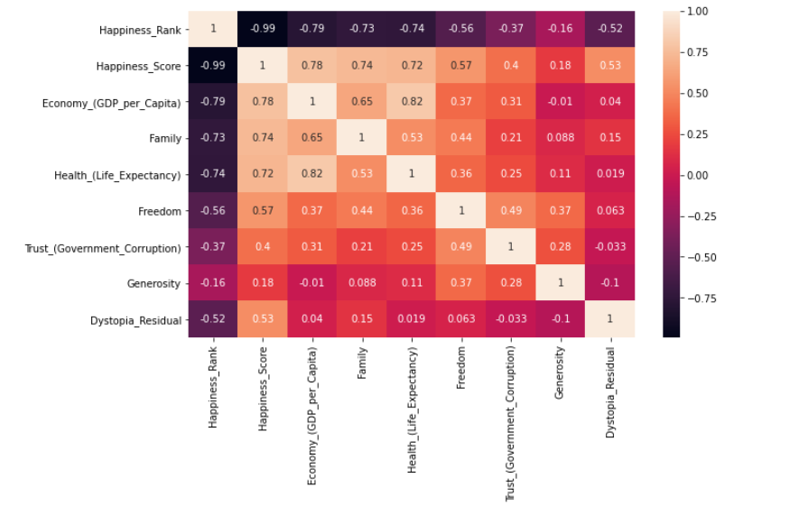
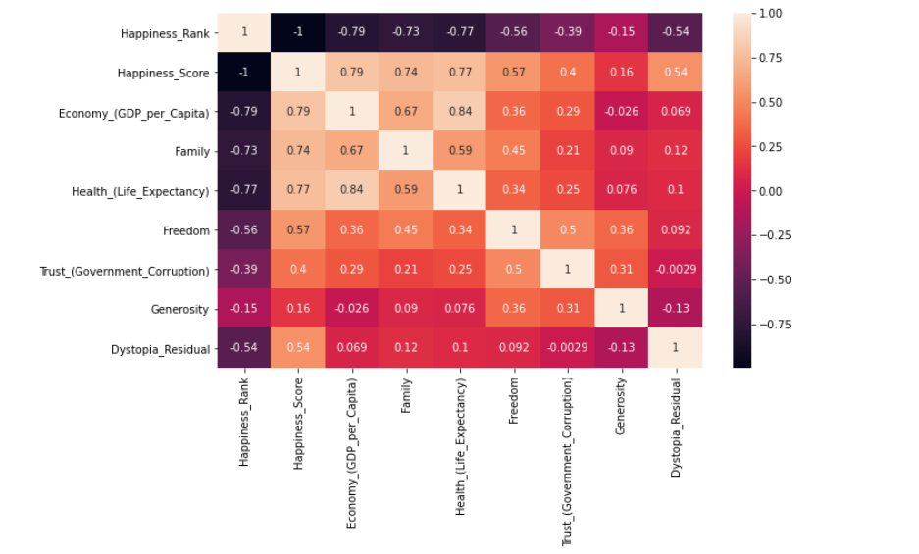
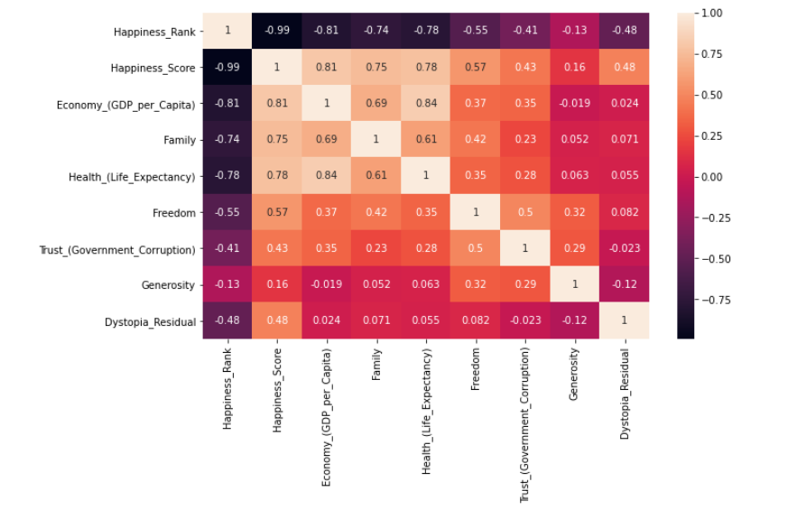
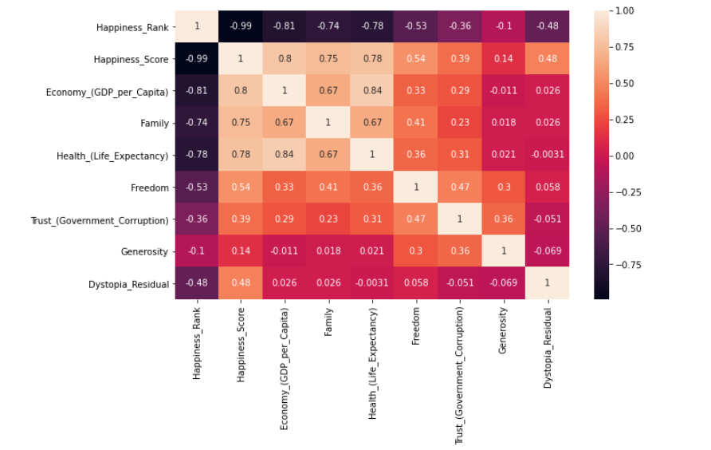
Are those factors correlated?
Year 2015
Year 2016
Year 2017
Year 2018

Slide 13

Factors Analysis

Slide 14
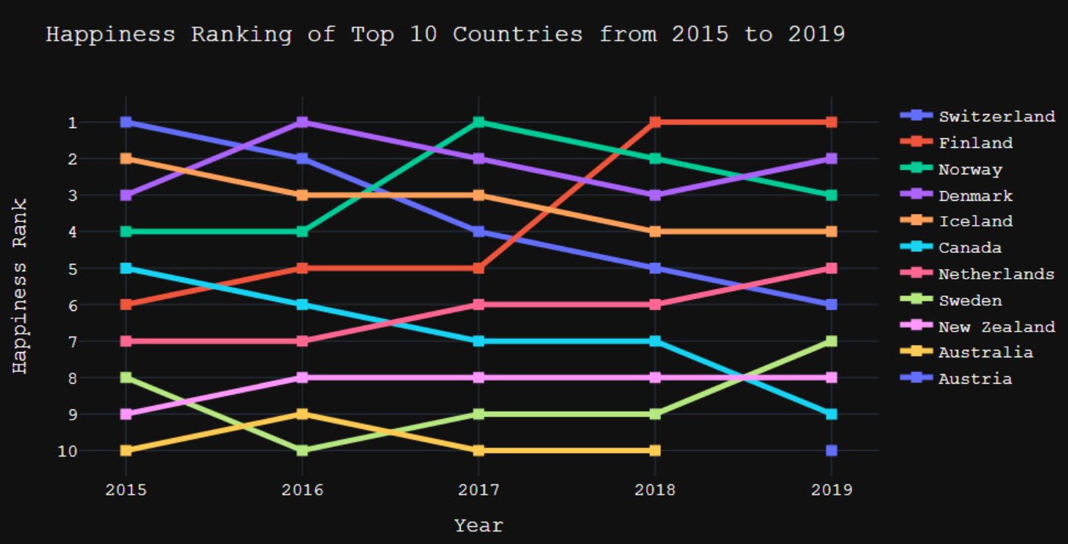
the top 10 countries From Year 2015 to 2019

Slide 15
Top 10 countries by Region

Slide 16
Bottom 10 countries Region

Slide 17
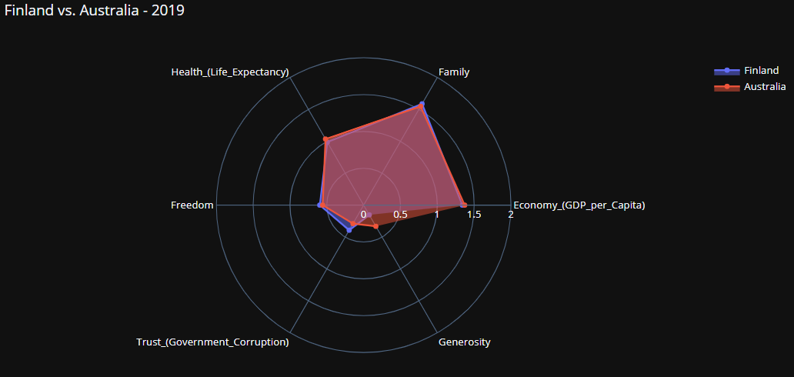
Australia VS top 1 country (2019)

Slide 18
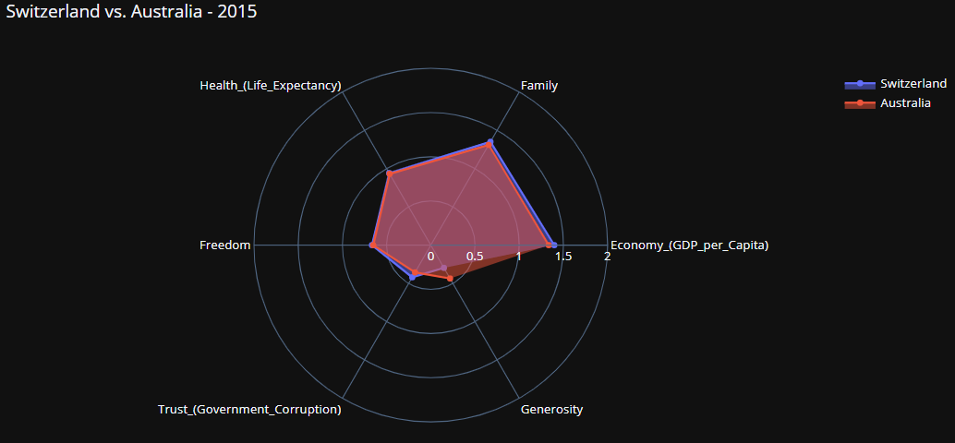
Australia VS top 1 country (2015)

Slide 19
Do you think we will be on the top 10 by the year of 2020?

Slide 20
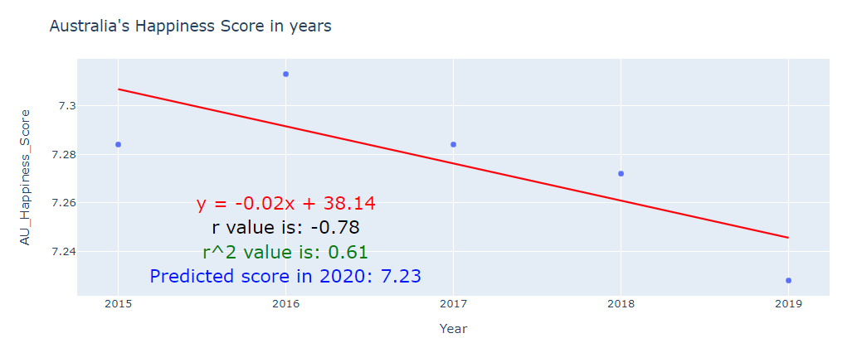
Prediction for Australia Ranking in Year 2020

Slide 21
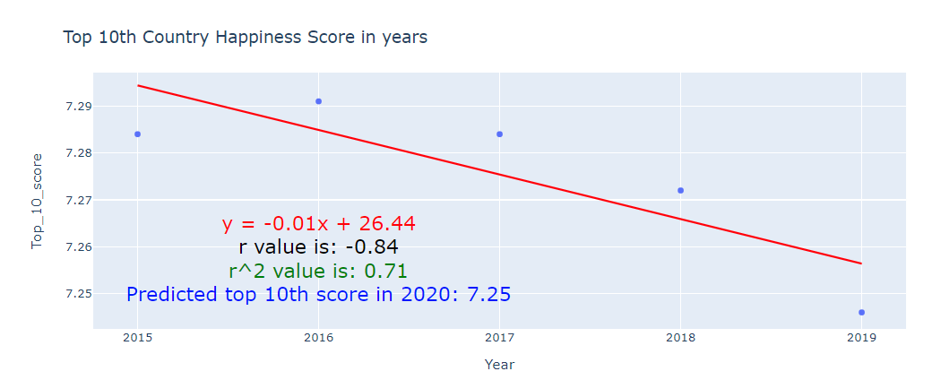
Prediction for Australia Ranking in Year 2020

Slide 22
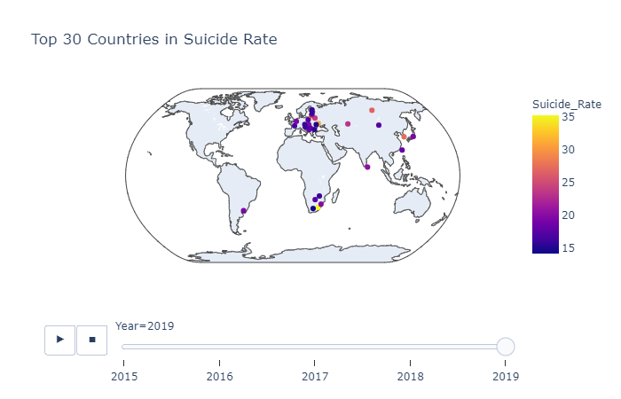
Bonus: Something Contradicting

Slide 23
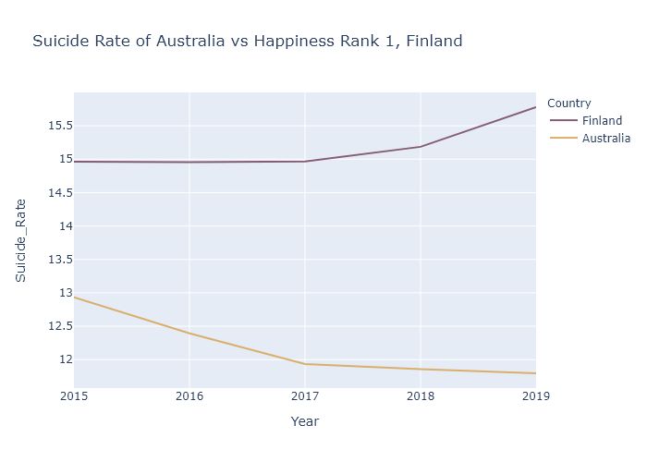
Bonus:

Slide 24
Conclusion
The world’s happiest countries are primarily in North Western Europe, North America, and Australia & New Zealand.
Economy (GDP per capita) is the most important factor in evaluating a country’s happiness.
Economy is also strongly positively correlated with other factors like Family and Health.

Slide 25
Information:
https://worldhappiness.report/ed/2020/#read

Slide 26
Jupyter notebook
Graphs, charts and tables

